Slide 1
Kinship Connected navigator programme
Kinship knowledge exchange July 2026

Slide 2
What is a Kinship Navigator programme?
Kinship navigator programmes offer information, advice and advocacy to connect kinship families with the support they need, when they need it.
They offer a mix of practical and emotional support including information, system navigation, peer support and advocacy.
Programmes aim to maximise kinship carers' ability to provide safety, stability and, where appropriate, permanency, enabling children to thrive within their family networks

Slide 3
Kinship Navigator Programmes
We are currently delivering our Navigator programmes in 35 local authorities in England, 1 local authority in Wales and we are launching in Scotland this month
Kinship Reach is our remote Navigator programme which offers kinship carers one-to-one support via telephone or video call. Support for up to 3 months
Kinship Connected is our Kinship Connected is an intensive 1-to-1, community-based support programme. Support for up to 6 months.
It is currently being evaluated in 4 new Local Authorities (Blackpool, Newham, Oxfordshire and Rochdale).

Slide 4
Kinship Connected
Background:
Developed by Kinship since 2013 initially in the North East, before being trialed in North London
Designed for all kinship carers, regardless of legal arrangement
Evolved over 13 years into a structured evidence-based programme
Built on 1-to-1 relationship-based support and local peer networks
Underpinned by person-centered and trauma informed approaches
Uses a strengths-based assessment framework
Strengthens local authority Kinship Local Offer, including connecting ecosystems of support

Slide 5
Kinship Connected
Kinship Connected is a community-based support programme designed to improve the wellbeing, resilience, and stability of kinship families.
Delivered by a specialist Kinship Navigator
Referrals from Local Authority and self referral
Intensive one-to-one tailored support
Home and community visits
System navigation
Facilitated support groups
Family celebration days

Slide 6







What the Kinship Navigator does
Emotional support
Advocacy
Practical casework
Trauma-informed listening, therapeutic parenting tools, building resilience
Statutory meetings, court hearings, school meetings
Applications for DLA, EHCP, housing, blue badge, immigration, passport applications & grants
System navigation
Goal setting and review
Facilitated support groups
Mapping local services and connecting carers to the right support
Co-produced SMART goals across wellbeing, confidence and service access
Monthly facilitated groups where carers connect, share and support each other

Slide 7
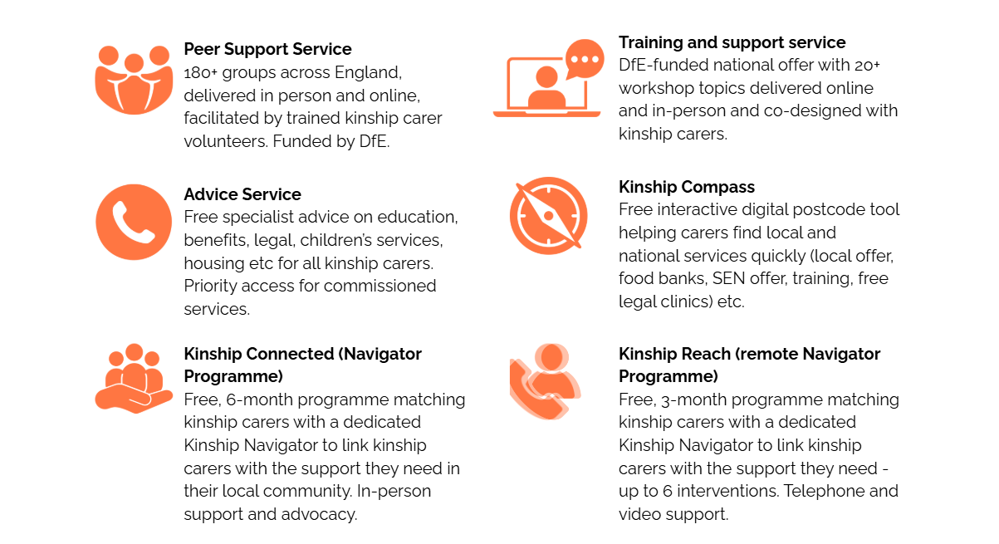

Slide 8
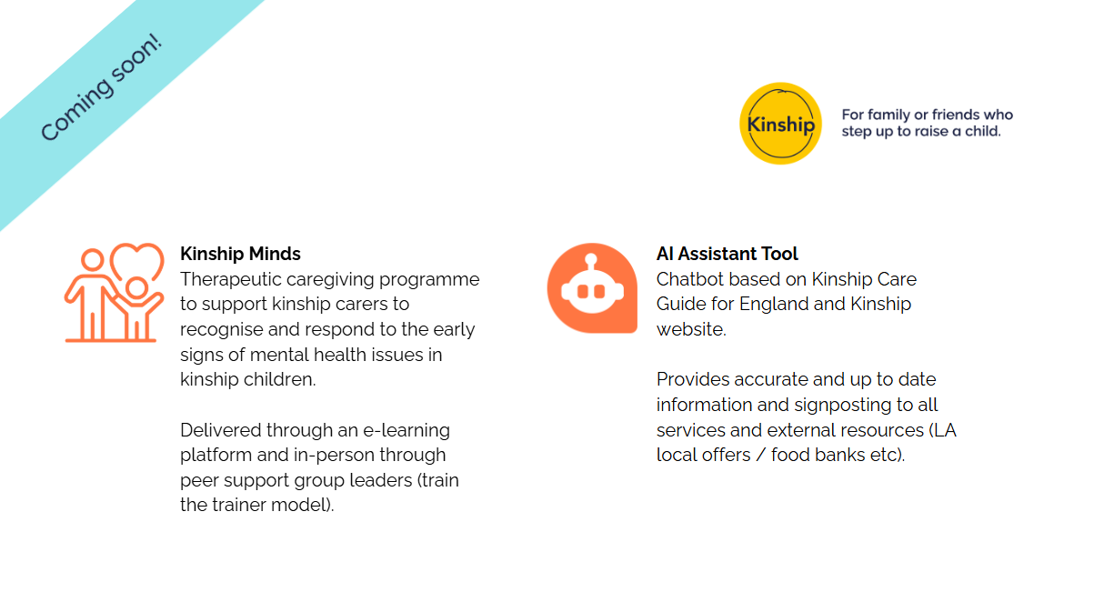
Notes:
I’m going to talk about our approach to developing services with kinship carers but before I do, I thought I’d so a quick run through of all our services. We’ll go training, peer support and advice in a bit more detail.
The kinship care ecosystem is incredibly complex. Our role is to support kinship carers to access the support they need – whether practical or emotional. Helping them as part of a strengths based approach to build resilience and to provide secure and stable homes for their kinship families. A big part of this is who we support them to navigate the different systems.
We also have a Someone Like Me Service – a listening service – trained kinship carer volunteers take up to 3 phone calls with a KC to provide emotonal support not advice. We also provide a printed copy of the Kinship Care Guide for England.
All of our services have been co-designed with kinship carers and continue to be.

Slide 9
Key outcomes for kinship families
Feeling more stable and settled in their caring role
Improving their own wellbeing and feeling less alone
Building their confidence to support their kinship child(ren)'s needs
Accessing financial, legal or practical information and support
Connecting with other kinship carers
Supporting their kinship child(ren)'s education or behaviour
Looking after their own health and wellbeing
Understanding their legal rights and options
Building stronger relationships with their kinship child(ren).
We measure outcomes using co-produced goal progress scales, the Short Warwick-Edinburgh Mental Well-being Scale (SWEMWBS) and the Brief Parental Self-Efficacy Scale (BPSES).
Notes:
Integrated CRM data infrastructure
Pre/post measures of self-efficacy (indicators of social connectedness,wellbeing and confidence)
Assessment of goals at mid-point and end
Programme fidelity (adherence, dosage, scope for quality)
Trial governance routine reporting (recruitment, safeguarding, outcomes)

Slide 10
“Our (Navigator) has been incredible. She builds trusting relationships with carers, and because she’s not the council, carers will often open up to her in a different way. She becomes that neutral person who listens, who hears them, and who feeds things back in a really constructive way.”
(Social worker from local authority commissioning Kinship )

Slide 11
Pilot evaluation: Kinship Connected
Amy Hall, Principal Advisor, Centre for Evidence and Implementation
Kinship knowledge exchange event, 14th July 2026

Slide 12
Kinship connected – a pilot evaluation
Pilot evaluation:
A “test run” of if and how procedures work in practice
Research questions
  Feasibility of conducting a full-scale trial
  Estimated effect of Kinship Connected on parental self-efficacy, kinship carer wellbeing, and probability of a child entering unrelated foster care (within 6 months)
  Recruitment strategies – insights into reach and retention
  What is actually accessed/delivered? What is BAU?
  Acceptability and appropriateness of the evaluation design
  Perceived impacts by kinship carers, Kinship Navigators, LA staff
  Are proposed mechanisms of change supported by the evidence?
  Unintended and negative consequences
  Readiness for delivery at larger scale & changes needed to the model for scale
  What resources are required for delivery (financial analysis)
Notes:
Full trials are expensive and time consuming; we want to test the processes and “iron out” implementation issues before committing to a full impact trial.
Pilots: not powered (i.e. not enough participants) to understand effectiveness but can show evidence of promise, i.e. the direction of the effect, qualitative insights etc. and start testing assumptions in the theory of change.

Slide 13
Why is evaluation important?
13
  We want to understand the impact of interventions for kinship families.
  Identifying and disseminating good practice to improve services.
Understand what works
for kinship families
Promote good practice
Better spending
decisions
Improve equity
  It is important that services do not leave anybody behind.
  Evidence based policy making to use local and national funding more effectively.
Notes:
Build evidence base for kinship support services.
Evaluation helps us understand if an intervention affects different populations differently or has any unexpected consequences.

Slide 14
Trial design
Wait-list randomised controlled trial (RCT):
Individuals are randomly assigned to immediately receive the 6-month intervention or to a 6-month waiting list during which they receive their LA’s ‘business as usual’ support.
We assess outcomes for all participants at 6-months:
Kinship carers’ parental self-efficacy
Kinship carers’ wellbeing
Probability of a child entering unrelated foster care
Balancing “gold standard” research methods with realities of delivery in children’s social care.
Compared to medical interventions, generating evidence for effectiveness in social care requires context-sensitive design.
Complex system, LA variation, flexibility
Child welfare – always the priority
Consent and data sharing
Business as usual, withholding support and level of need
Notes:
RCTs are the gold standard of understanding impact, because they allow us to compare what happens when participants receive the intervention compared to what would’ve happened anyway in the absence of the intervention.
This study is a waiting list RCT because 1) there is good evidence for kinship navigator services from the USA and 2) to secure LA buy-in.

Slide 15
Comparison groups… why?!
Kinship Connected
Random assignment
Control
Baseline measures
Endline measures
Notes:
Change happens over time anyway – accessing other support, personal resilience, learning with experience, changes in personal and financial situations. How do we know what kinds of changes and how much change is attributable to the support they receive from the intervention of interest?
Randomisation
Randomisation means we can assume that any “invisible” or unobservable characteristics are the same at baseline – i.e. all the things that we can’t measure or account for like prior engagement with services, resilience, household socioeconomic status.
Randomisation is being stratified by two variables; LA (so that each LA has a 1:1 ratio of intervention : control) and referral pathway (LA referral : self-referral, as they are likely to identify different populations, with different baseline characteristics such as prior engagement with support and motivation for engaging with support)
Assume that both groups are affected by any changes to national and local policy in the same way

Slide 16
Estimate resources required for delivery
Kinship carers randomised
IPE
Outcome measures (baseline / follow up)
Interviews with kinship carers
RCT
Delivery costs (start-up and recurring)
Interviews with KC delivery team and LA practitioners
Cost analysis
Understanding referrals, take up and activity
Notes:
Need all three strands to understand how the programme is working and if it is working; what were the barriers, what can be improved, etc.

Slide 17
Outcomes and outputs
Appropriateness for progression to a full trial informed by all strands
Immediate funding for delivery in four LAs, supporting 200 families
Generating evidence for kinship navigator programmes in the UK context
Additional work to explore best practice for engaging kinship carers from different backgrounds in services and research

Slide 19
Navigator Programmes and FFP: Golden threads
Relationship-based practice The Navigator relationship is the vehicle for change – consistent, trusted, long-term.
Strengths-based approach Assessments follow the Signs of Safety model, a structured framework for understanding risk and protective factors that mirrors FFP's expectation of rigorous, evidence-based assessment within a strengths-based approach.
Trauma-informed practice Kinship families arrive having experienced crisis. Navigators are trained to understand this. FFP embeds trauma-informed approaches across the system.
Independent, trusted support Navigators are independent of the local authority. Kinship carers share more openly – enabling more genuine, family-led planning.
Whole-family, community-based Support is delivered in homes and community settings. We are actively co-locating Navigators within Family Hubs.

Slide 20
Navigators in the FFP system: practical links
Family Network Support Packages: Navigators can help kinship carers understand and access FNSPs, grants and financial support – removing the practical barriers.
Family Group Decision Making: Navigators build kinship carers’ confidence and would help support meaningful engagement in FGDM, ensuring family networks have a genuine voice in planning decisions.
Placement stability as prevention: Kinship Navigator programmes support stability and prevents breakdown.
Co-location in Family Hubs: Navigators working from Family Hubs creates a non-stigmatising, accessible entry point for kinship families – directly supporting the integrated community model FFP envisions.

Slide 21
Supporting a child’s family connections
Helping children understand their story: By empowering kinship carers to have age-appropriate conversations about why they live with their kinship carer.
Keeping children safely connected to birth family Supporting carers to manage contact so children maintain relationships with birth parents and siblings.
Making sure children's voices are heard: Supporting carers to represent the child's wishes and feelings in reviews and meetings
Keeping children stable and safe Supporting kinship carers to understand their child’s trauma and teaching therapeutic parenting skills.

Slide 22
What would Navigators mean for your area?
1. Where do kinship families in your area fall through the cracks? What needs go unmet, where do things break down, what keeps you up at night?
2. If Navigators came to your area, what would the benefits be? Think about carers, children, your team and the wider system.
3. What would the challenges be? Be honest think about capacity, culture, commissioning, relationships with kinship carers.
4. What do professionals need to make it work? What would need to be in place?

Slide 23
Are Navigators a benefit to the Families First reforms or are they an essential part of the system?

