Slide 1
Kinship 2026 Knowledge Exchange: Building the kinship care system that families need: Where are we now and what's next for policy and practice?
LinkedIn: @kinship-charity

Slide 2
Welcome from the conference chairs
Dr Beverley Barnett-Jones, Trustee of Kinship and Nurture Futures Co-Founder
Tim Fisher, Practice Lead, Kinship

Slide 3
North East Lincolnshire Kinship Zone
Ann-Marie Matson, Director of Children’s Services, North East Lincolnshire Council
Lisa February, kinship carer

Slide 4
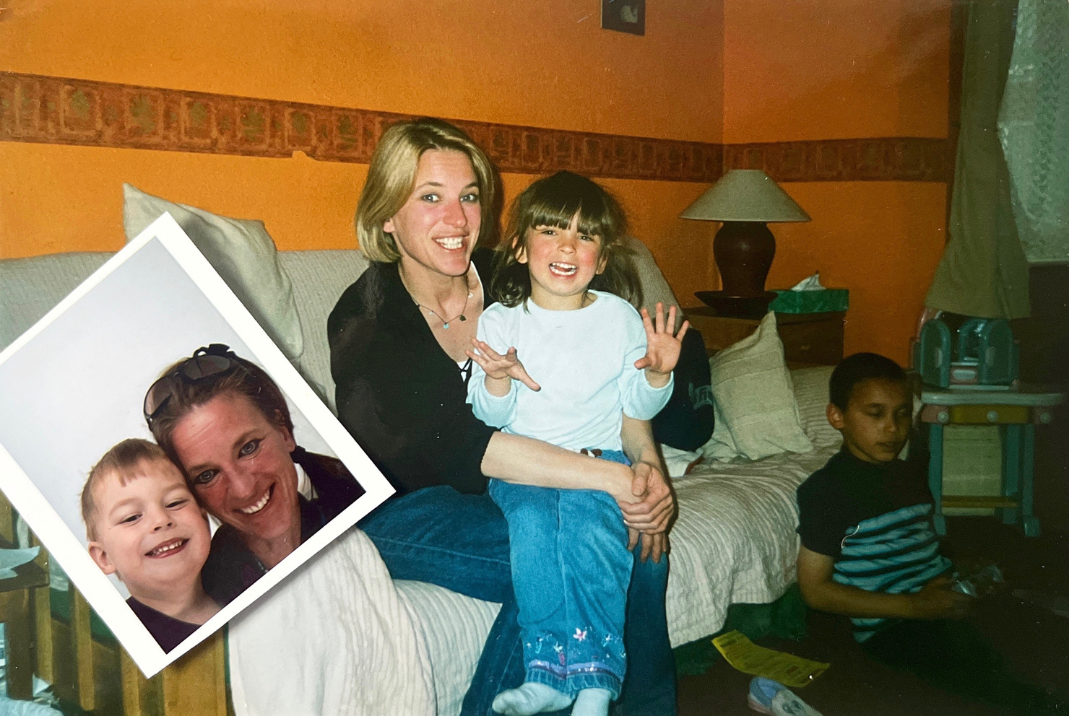
Sister, mother, other:
Our Kinship Care story

Slide 5
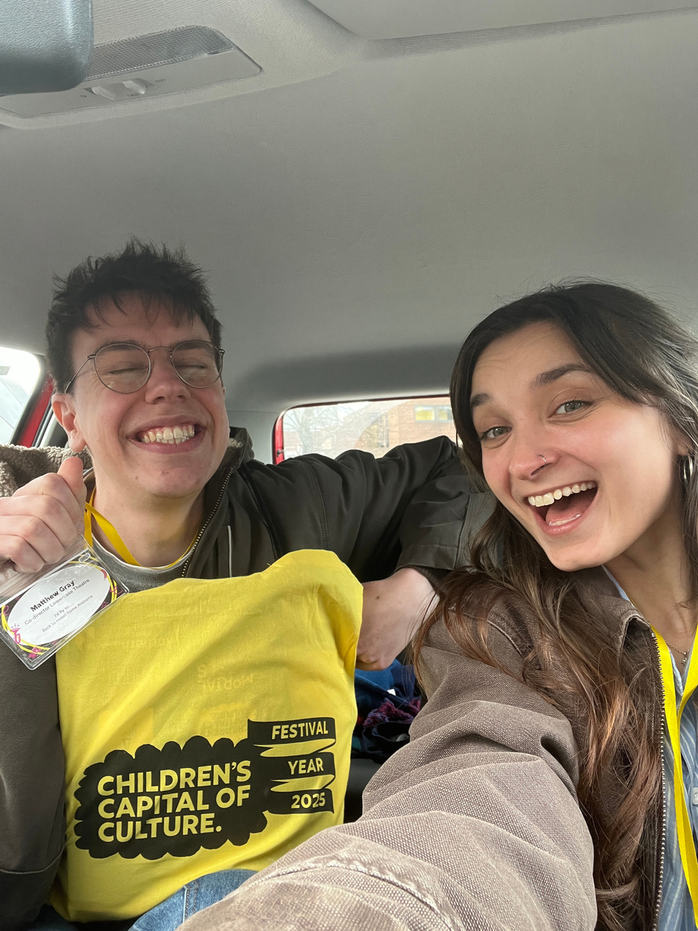
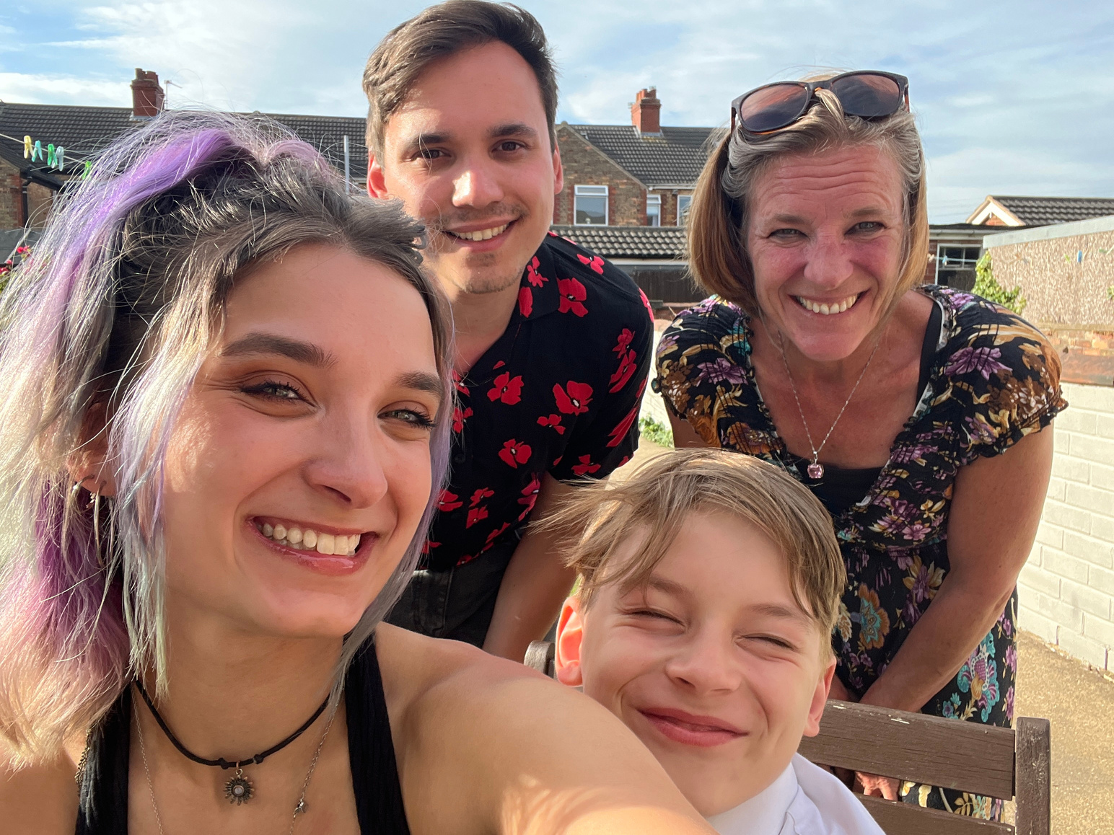
A bit about me

Slide 6
What is Kinship Care?

Slide 7
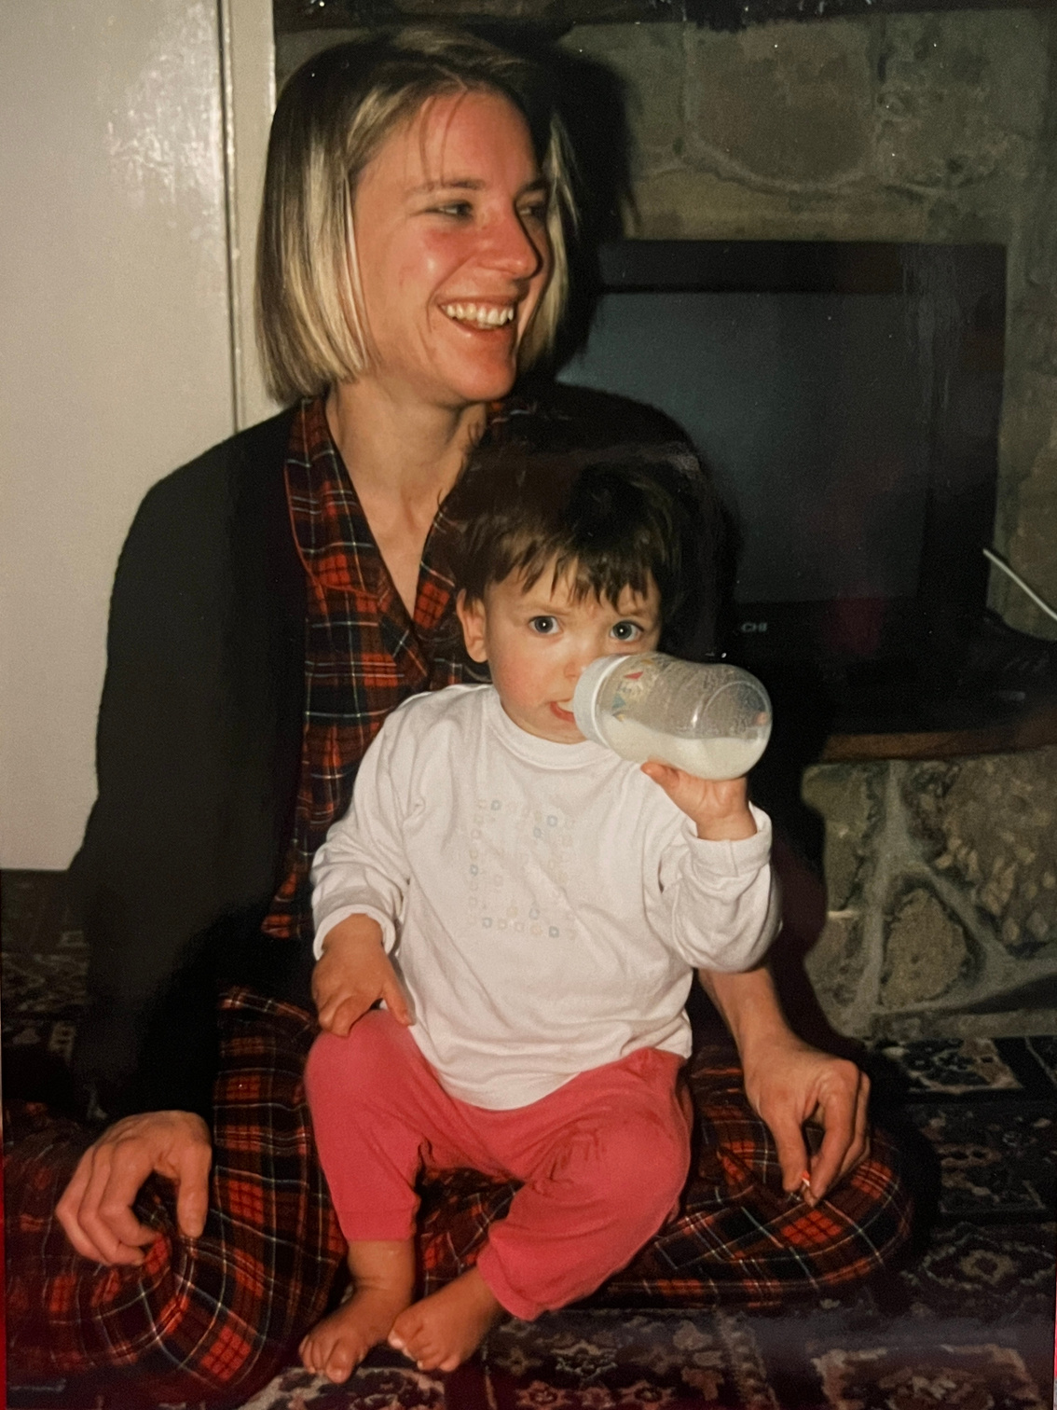
Kinship care
is loss.

Slide 8
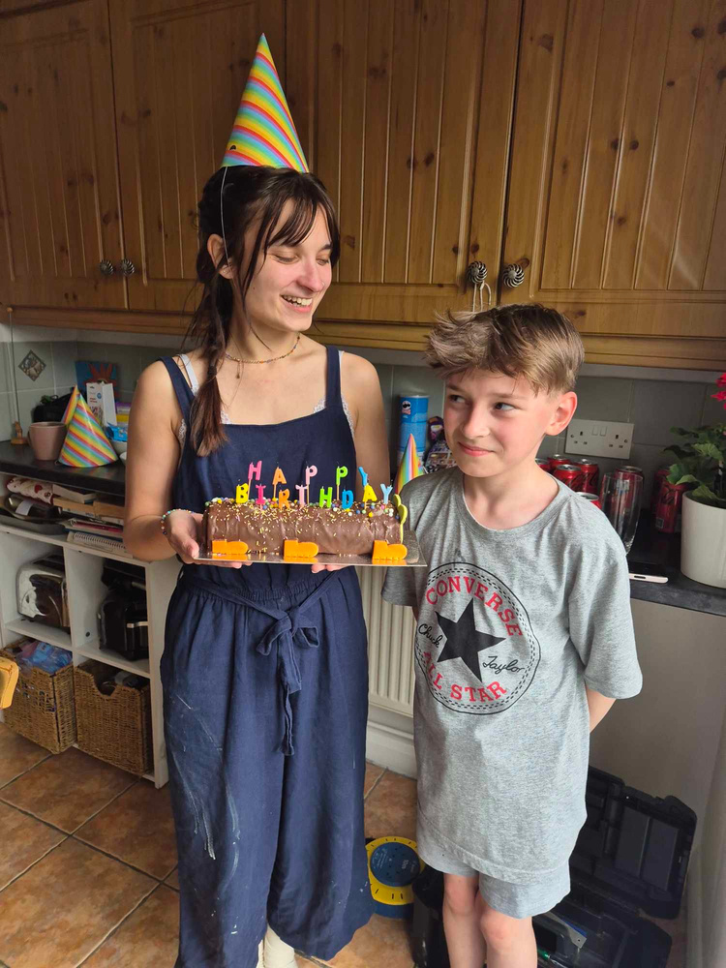
Kinship care
is celebrating
the small things.

Slide 9
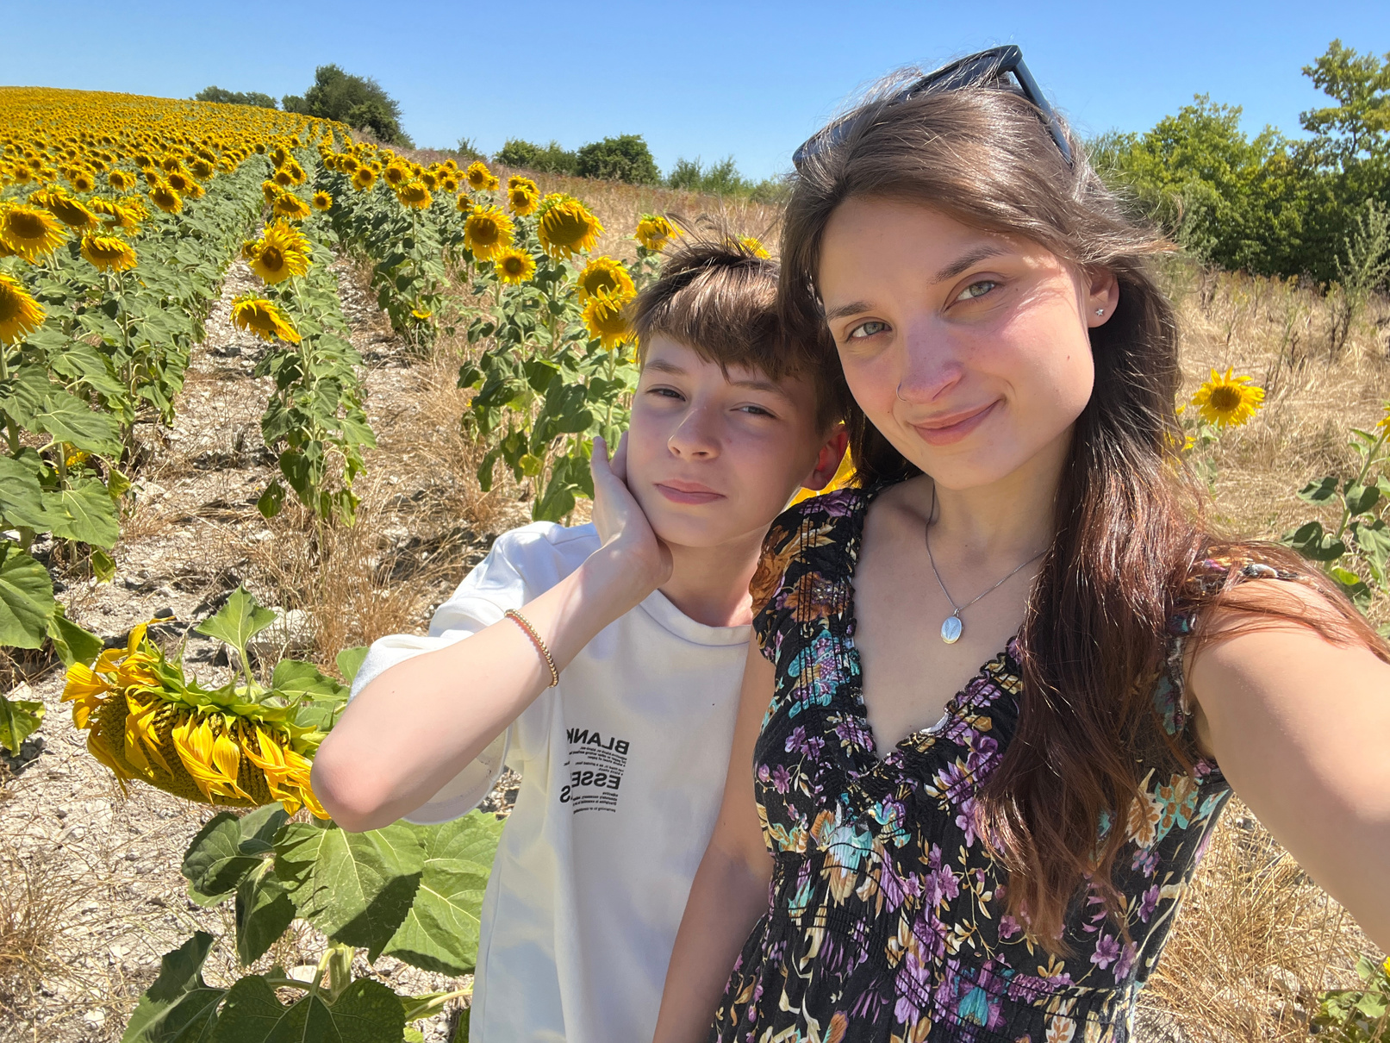
Kinship care
is advocacy.

Slide 10
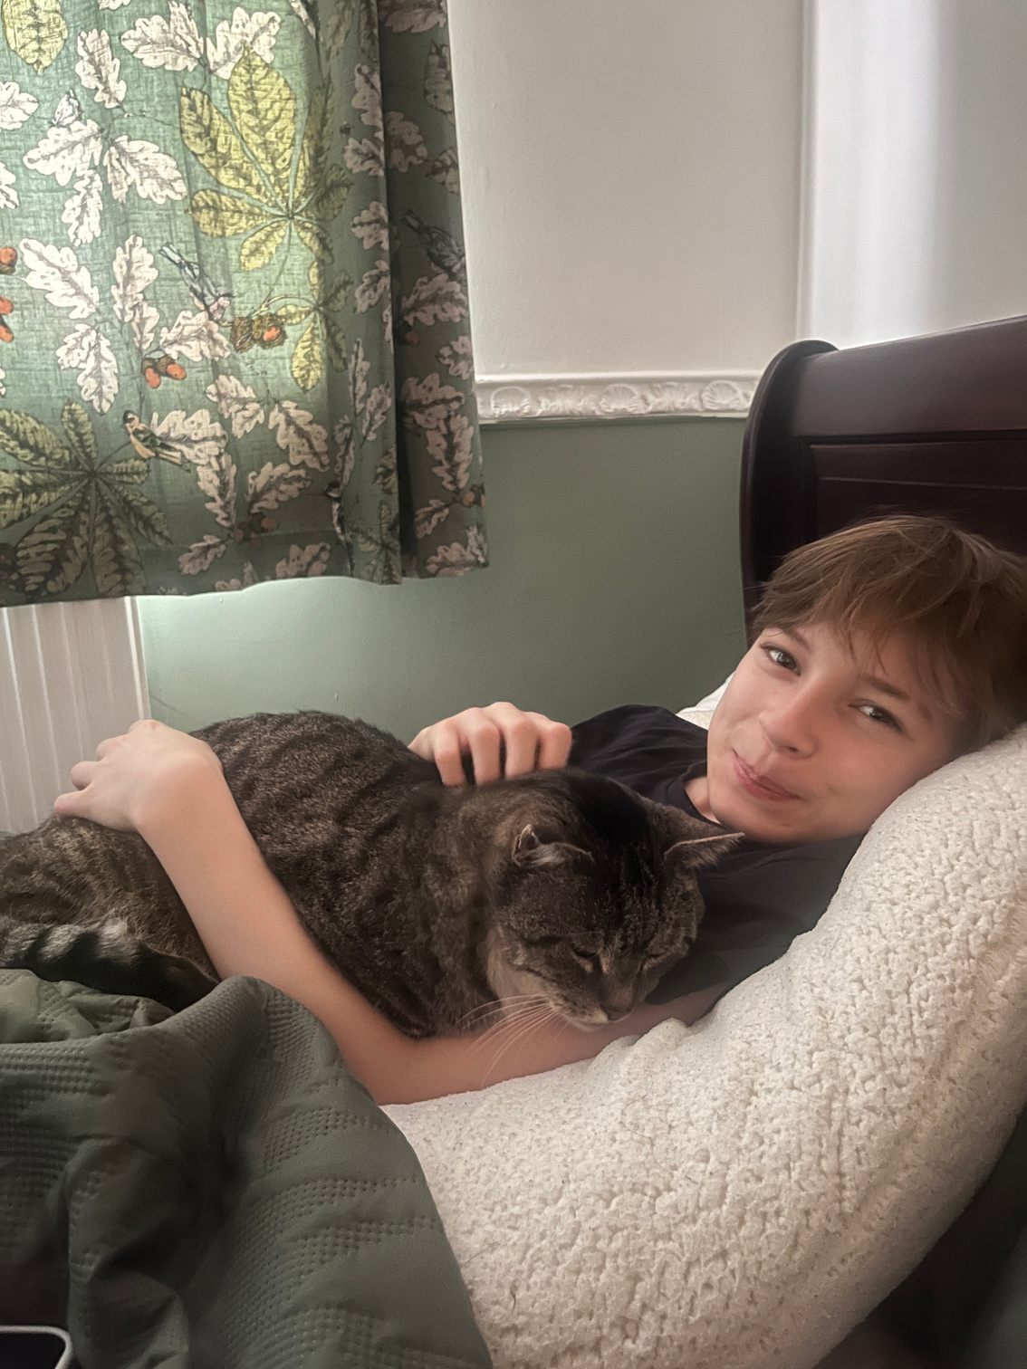
Kinship care
is exhausting.

Slide 11
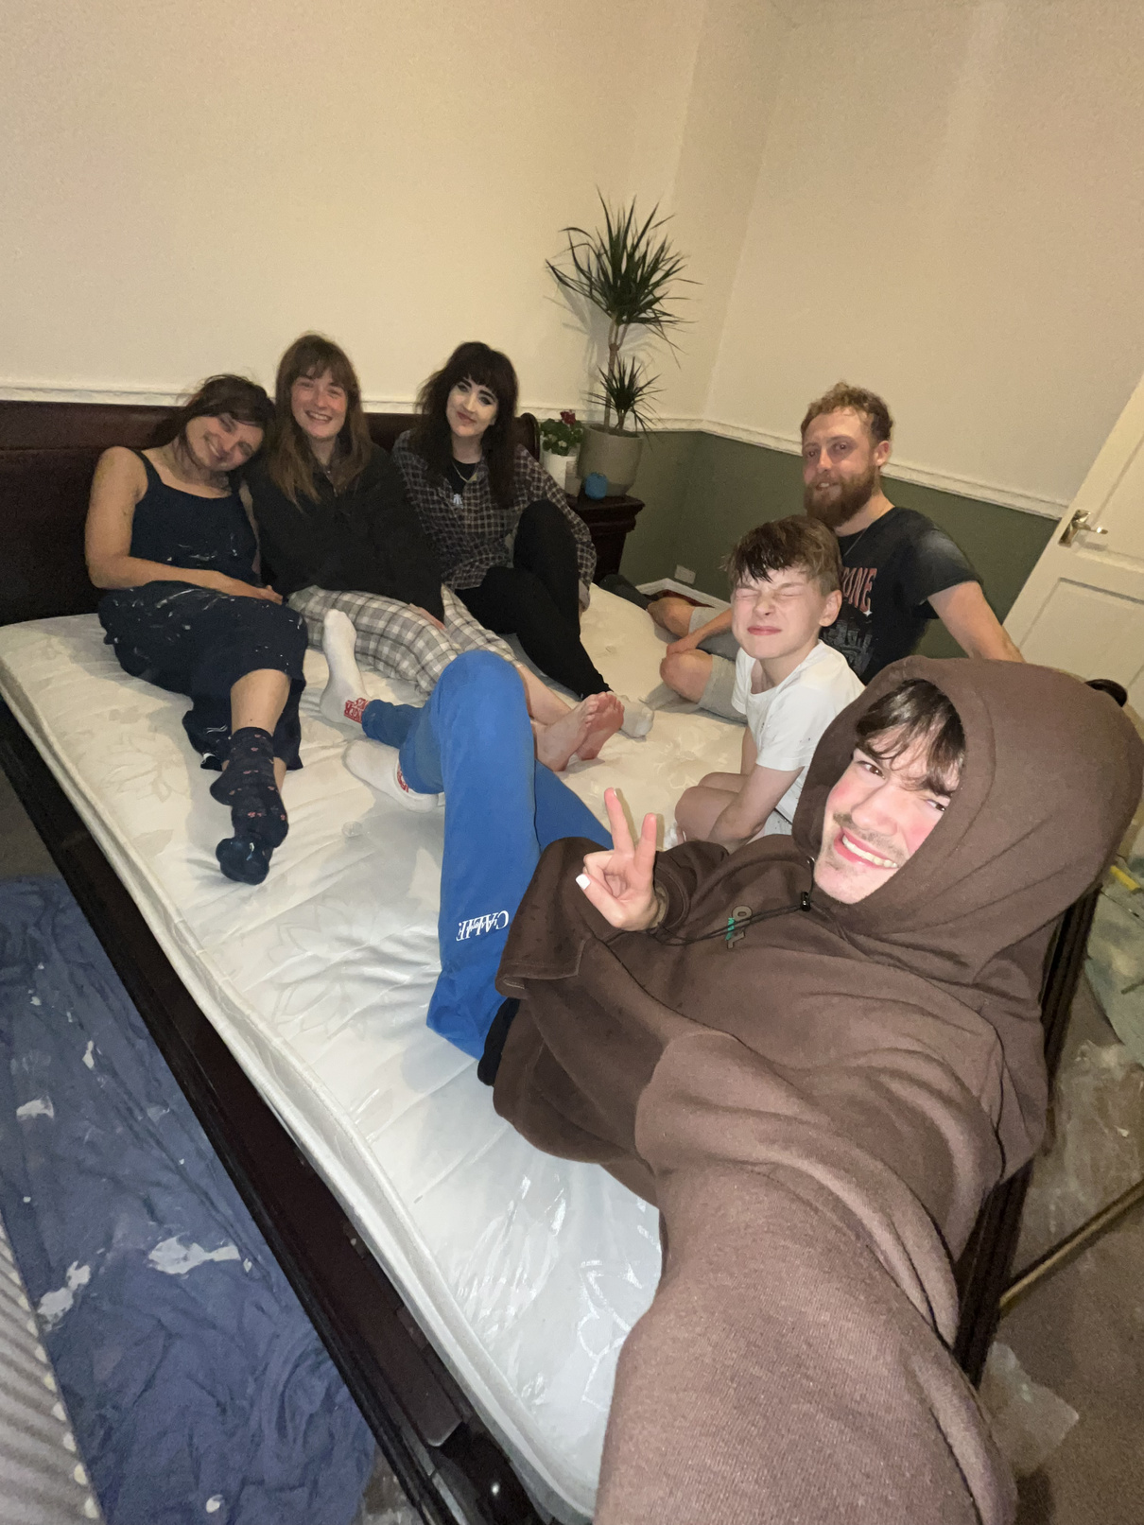
Kinship care
takes a village.
(...or two)

Slide 12
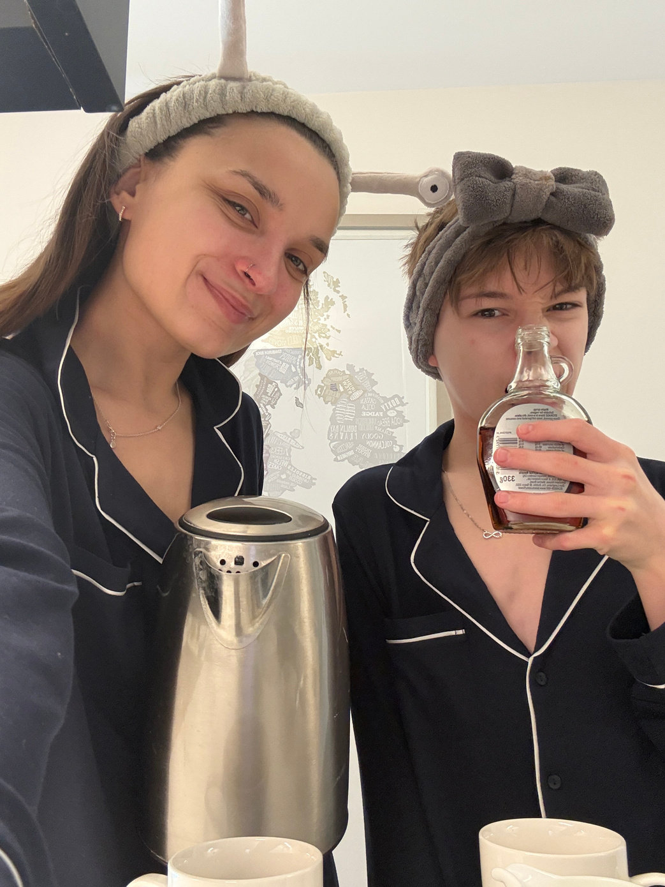
Kinship care
has been the biggest gift of my life.

Slide 13
If it takes a village...
how can we all be
better villagers?

Slide 14
Kinship Care
Building the kinship care system that families need: where are we now and what's next for policy and practice
Yvette Stanley
National Director, Regulation and Social Care
July 2026

Slide 15

A personal journey

Slide 16
Our ambition - frameworks that are part of an agile, unified system of inspection and regulation
Aligning inspections and statutory guidance
Aligning our inspection frameworks to reflect that social care providers and local authorities have a shared responsibilities to the same children
Making children’s enduring relationships a central focus
Supporting local authorities and children’s social care providers to meet the needs of children with complex needs
Putting children, young people and families' voices at the centre of inspection and regulation
We have just launched our consultation proposals to reform both frameworks, following the Department launching their Working Together consultation.

Slide 17
ILACS evaluation areas
New evaluation areas to better align with the Children’s Social Care National Framework:
  family help (separated)
  child protection
  family networks (new)
  children in care
  care leavers
  impact of leaders
Golden threads – how the local authority:
  helps children create enduring relationships
  engages with children and families
  collaborates with other relevant agencies

Slide 18
Law Commission and observations
Legal gaps and issues
Assessment and support gaps
Entitlements for children
Clarity, transparency, equity, funding
The inspection and accountability system which underpins.

Slide 19
Break

Slide 20
Kinship in government: progress and prospects
July 2026

Slide 21

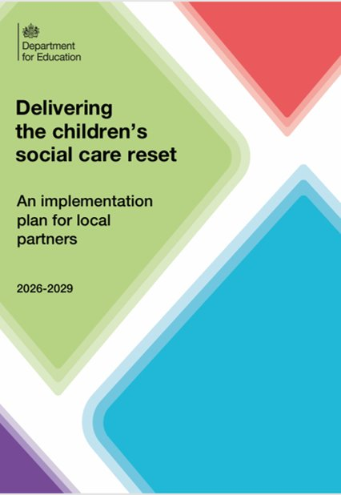
The government is implementing generational reform to children’s social care to rebalance the system away from crisis response towards earlier intervention
In November 2024, we published Keeping Children Safe, Helping Families Thrive which set out a vision for a transformed system. ​
In May 2026, we published Delivering the Children’s Social Care Reset: an implementation plan for local partners. ​
    The plan provides a framework for whole-system reform of children’s social care in England and sets out our vision to:
      Keep children within their families wherever safe and possible
      Build long-term, loving relationships for children
      Shift the system from crisis response to early intervention
      Success will look like:
        Fewer children in care due to earlier support
        More children living with family or kinship carers
        Improved safety and reduced harm
        More stable placements and lasting relationships
        Stronger workforce and better outcomes

Slide 22
We have three main objectives, to which each of our current activities are aligned:
Kinship care is central to our vision for children’s social care by enabling children to stay within their family networks wherever safe and possible
1. Enable more families to stay together by supporting family networks and family led solutions
2. Where children cannot remain safely at home, we remove barriers to enable more children to live in stable and loving kinship arrangements
3. Once in place, kinship arrangements are well-supported, and children are given the opportunity to thrive
Activities:
Published Kinship Care statutory guidance for local authorities and a guide on evidence with Foundations. This guidance is due to be updated later this year.
Mandating local authorities to publish a clear and accessible kinship local offer.
Virtual School Head role to promote the education of children in kinship care will become statutory in Sept 2027.
Funding delivery of over 140 peer support groups across England and delivering a package of training and support for all kinship carers.
Adoption and Special Guardianship Support Fund helps kinship families access therapeutic support for children - £55m for 2026-27 and the fund will continue until 2027-28.
Improving our data and evidence on the needs of children in kinship care by adding kinship to the School Census from Autumn 2026.
.
Activities:
  Mandating local authorities to offer family group decision making to families at pre-proceedings, where that is in the child’s best interests, through the Children’s Wellbeing and Schools Act 2026.
Funding the Law Commission to undertake a comprehensive review of the legal framework surrounding kinship care
Kinship Zone LAs are delivering Family Network Support Packages and focussing the design of their services around empowering and supporting more family networks.
Activities:
Launched the Kinship Allowance Pilot in 7 local authority areas, known as Kinship Zones. The pilot will test whether providing eligible kinship carers with an allowance equivalent to the Fostering National Minimum Allowance improves stability and outcomes for children.
We introduced kinship leave in DfE on a par with adoption leave. The government has also launched a review of the parental leave system, which will consider whether the support available meets the needs of working families, such as kinship carers.
The National Kinship Care Ambassador advocates for kinship families and supports practice across the whole system:
  Published a report on improving kinship local offers to support LAs to produce KLOs that are responsive to the needs of kinship families.
  Leading DfE research on children’s lived experiences in kinship care, with findings to inform policy and practice.
  Supporting the Kinship Zones pilot, providing guidance, challenge, and sharing learning to help local authorities develop robust, deliverable plans.

Slide 23
Despite significant progress, we know from our engagement with the sector that there are still challenges and opportunities to go further in our support of kinship families
Kinship often sits with fostering and permanence services, limiting opportunities for earlier intervention and whole family support.
There is variation in practice and support for kinship families across England.
Kinship local offers can be centred around what an LA provides rather than the wider partnership.
Support for kinship families often depends on legal status rather than family need.
The National Kinship Care Ambassador is developing national kinship standards, which will form part of revised statutory guidance for local authorities, helping create a more consistent approach to kinship care.
The Law Commission’s review will consider whether the legislative framework meets the needs of kinship families. We are strengthening our evidence base on the needs and experiences of kinship children and improving identification of them.
Families First Partnership Programme reforms present an opportunity to maximise the benefits of earlier, multi-disciplinary support for the whole kinship family (formal and informal) and promote stability.
The NKCA has published a report on Improving the Kinship Local Offer including insights on improving partnership working and is delivering learning events on best practice.
What is the priority for local action? What needs to be done centrally?

Slide 24
Well-supported kinship care: learning from kinship navigator programmes in the USA
Dr Lucy Peake, CEO
July 2026
Notes:
There continues to be a growing focus on kinship care. Where possible, when children can’t be raised by their parents, we want them to remain within their family network. With people who know and love them, who are committed to them. Where they will generally do better than the alternative – the care system.
We all work in kinship care. We know the effort that is going into ensuring that kinship families get the support they need. But for those of us who speak to kinship carers regularly, we also know that while we are making progress, too many kinship carers face challenges financially, practically, emotionally. For the past few years, our annual surveys have found that the lack of support available means that around 1 in 8 kinship carers are concerned that they won’t be able to continue.
Together, we are making progress. Alongside the welcome efforts of local authorities to develop Kinship Local Offers, and the extensions in support from virtual schools, Kinship is delivering 2 national services, thanks to DfE investment. This DfE funding has enabled an expansion of peer support and training. These services are co-designed with and for kinship carers. We’re proud to have delivered over 10,000 training attendances and to be working with an incredible community of kinship carer volunteers to run over 180 peer support groups across England. This peer support, advice, information and training means that kinship carers will be better informed, more confident, more able to access support, and ultimately, more able to meet their children’s needs. They will also feel more connected to each other and a community, less lonely and isolated, and crucially, more able to support each other and to positively influence the development of services and policies as we build a well-supported kinship care system. They are incredible change makers.
Alongside these vital services, we’re also seeing the financial allowances pilot, innovations within the Kinship Zones and Families First agenda, and we are pressing hard to secure paid leave for kinship carers through the parental leave review, and ongoing commitments to fund therapeutic support for children in kinship care. But there is more that we can and must do.
Today, I’m going to talk about the development of Kinship Navigators in the USA. It’s a story that starts with listening to kinship carers, enabling them to shape, build and deliver an approach that improves access to advice, information and support. It’s about the what and the how – who delivers the support, how the deliver it, and how it feels? It’s about meaningful involvement, long-term partnerships, long-term funding and a commitment to long-term evaluation to refine services and measure impact.
It’s about the way that kinship carers, the voluntary sector, statutory services, evaluators and policy makers have worked over 20 years to build an approach that delivers what kinship carers want and the kind of impact that means that the US federal government will provide match funding to US States to implement it.
It’s about kinship carers helping shape an approach that is becoming seen as essential infrastructure in the US’s ‘kin-first’ approach to children’s social care.
It’s about how well the kinship navigator approach aligns with current reforms, and the opportunity to embed it as a key pillar of a well-supported kinship care system.

Slide 25

Kinship Navigators – learning from USA
Churchill Fellowship – Summer 2025
Churchill Fellowships are about looking at how other countries are developing solutions to issues we face and bringing that learning back to the UK
Visited Navigator programmes in 4 states, seeing how it works on the ground in Washington State, Florida, New York and New Jersey
Attended a national kinship conference featuring Navigator programmes from 18 states and 1 tribal nation
Learnt from kinship leaders in state agencies, national and local non-profits, policy makers and evaluators
Notes:
I’m going to draw on my recent Churchill Fellowship to talk to you about some of the people I met in Washington State, which has one of the most established Navigator programmes. I’ll talk about how it was developed, and what it could mean for us in the UK

Slide 26
What is a Kinship Navigator programme?
Kinship navigator programmes operate across defined areas. They help kinship carers to navigate complex systems to find the support their families need
Kinship navigators are kinship experts who offer:
  1-1 support and advocacy
  Access to specialist information and advice
  Support groups
  Family activities
Navigators raise awareness and understanding about kinship care and influence more responsive and more connected services and systems
Outcomes include improved stability and well-being for children
Notes:
Supporting kinship carers
Changing the system

Slide 27
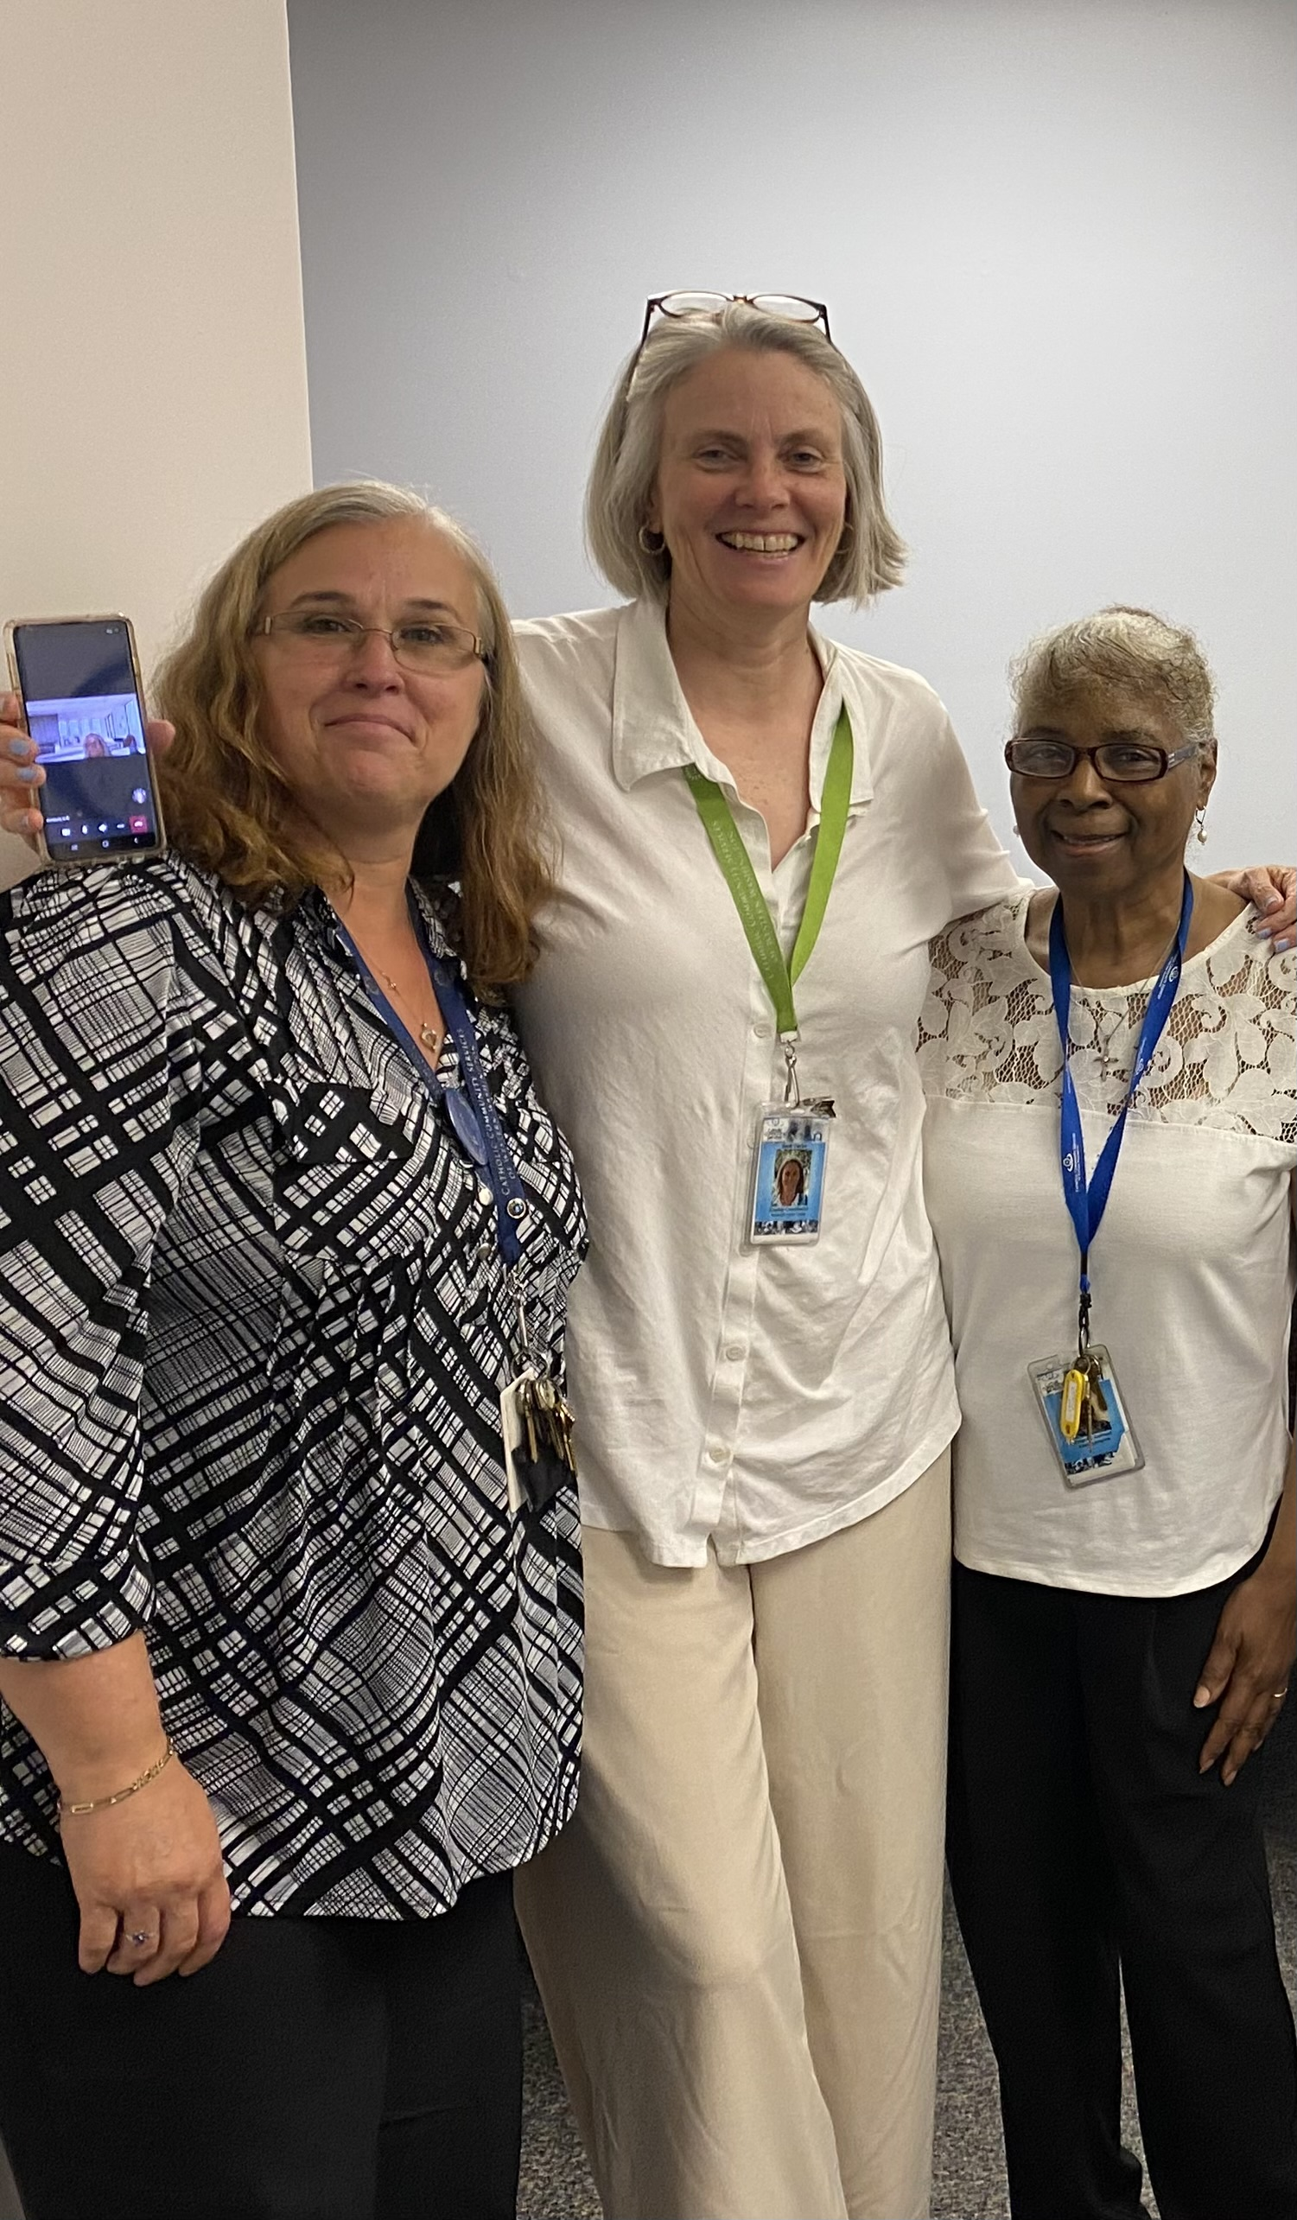
Miss Cynthia and Suzanne, kinship carers, navigators and rock stars of Greater Seattle
Navigator programme developed over 20 years
designed with and for all kinship carers (legal orders and none)
1-1 support delivered by kinship navigators (often kinship carers)
Kinship community
  Peer support
  Family activities for kinship carers and children and an annual family camp
Barb, committed non-profit leader
Delivery purposefully through non-profits
trusted by kinship carers, able to reach informal carers and tailor for tribal nations
strengths-based approach
long-term commitment to supporting kinship families
key role in influencing local ecosystems and providing holistic support and effective gateways to other services
Notes:
Background, what it includes and why it works

Slide 28
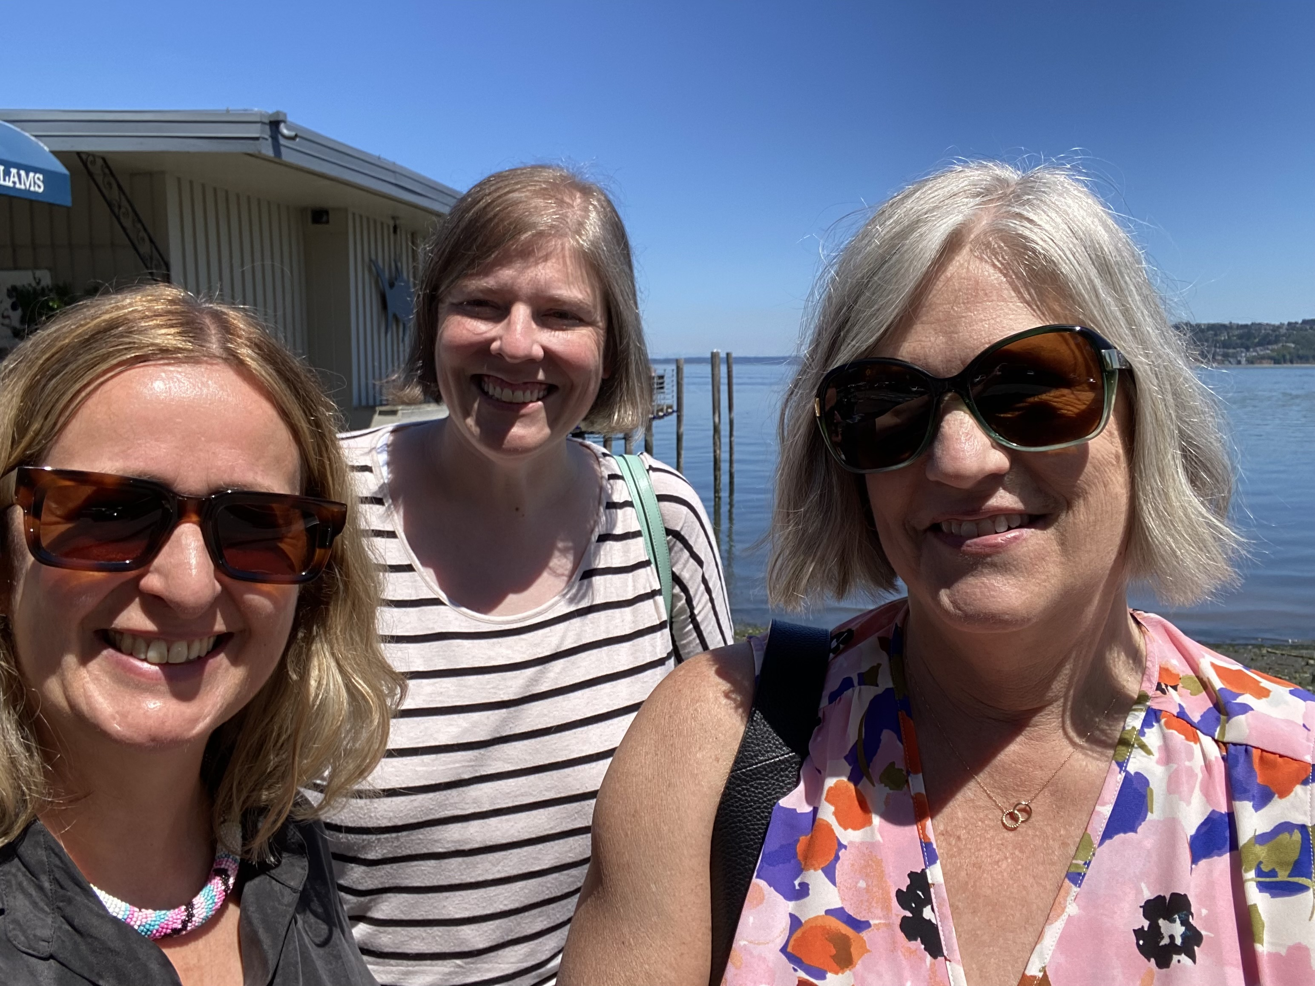
Ros, statutory service leader. Amanda supports delivery organisations to implement the programme and support evaluation
Long-term partnership between state agencies and non-profits
Long-term funding for evaluation (7 years, led by Dr Angelique Day)
Long-term commitment to Kinship Care Oversight Committee - with State mandated kinship carer representation
Brings together statutory and non-profit agencies State-wide.
Responds to kinship families’ needs strategically and operationally.
Identifies priorities, connects services and unlocks assets to collectively provide accessible support for kinship families
Notes:
Why it works

Slide 29
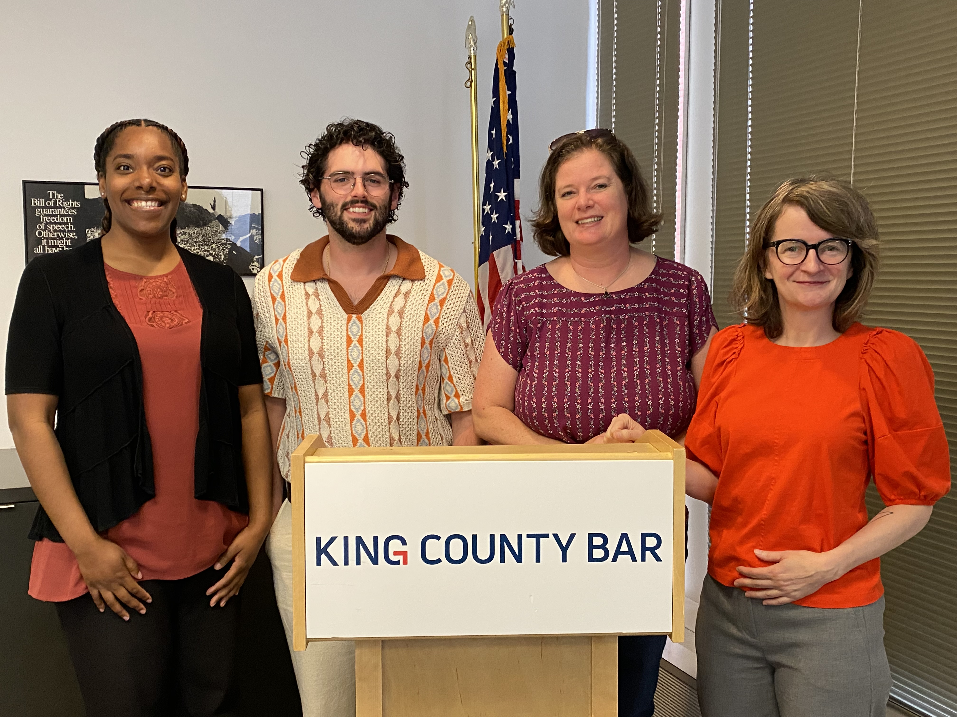
King County Bar Association
Kinship Care Oversight Committee identified need for independent legal advice
State funds a free and independent legal advice service with clear referral pathways to and from kinship navigators

Slide 30
Kinship Navigators – the opportunity
Strong evidence base to suggest Kinship Navigators improve access to services and benefits, kinship carer knowledge and confidence, social support, ability to meet children's needs and family protective factors
States are eligible for federal matched funding if they are delivered under certain models – programmes developing as core infrastructure
Aligns to Foundations’ Kinship Care Practice Guide recommendations and principles
Notes:
The Practice Guide was produced to support senior leaders and commissioners in local areas to commission and develop effective services to support kinship families. Recommendations are drawn from an international review of the best-evidenced interventions for improving outcomes among kinship carers and children and young people in kinship care.

Slide 31
Kinship Care Practice Guide (Foundations)
Key Principle 1: Support for kinship carers should take into account the specific needs and strengths of kinship carers.
Key Principle 2: One-to-one relationships and high quality casework should be at the heart of support for kinship families.
Key Principle 3: Kinship families need to be made aware of the support they are entitled to, and local authorities should actively work to address barriers to accessing support.
  Kinship carers reported benefits to receiving support from non-statutory services, and support from these services can have a positive impact on kinship families.
Notes:
The Kinship Practice Guide contains key principles: which summarise the needs, experiences, and preferences of kinship carers in the UK, and evidence on implementation and design of services and interventions. They are intended to support local authorities to deliver accessible, acceptable, and effective interventions.

Slide 32
Kinship navigator programmes in the UK
Kinship Connected is Kinship’s flagship Navigator programme – developed with kinship carers and local authorities since 2013.
It is an intensive 1-to-1, community-based support programme designed to improve the wellbeing, resilience, and stability of kinship families.
The intervention is delivered by specialist Kinship Navigators who support kinship carers for up to 6 months
Kinship Reach is a remote version of the programme that runs on a similar model with online/telephone support for 3 months
Notes:
I started by talking about Miss Cynthia and Suzanne, the rock stars of Greater Seattle. As I learnt about the approach they had shaped over 20 years, I couldn’t help but compare it to a service that kinship carers helped us to develop, starting in the North East of England in 2013. I told them about some of the kinship carers I know and how they came together with social workers, family lawyers, and Kinship to design and refine Kinship Connected.
We reflected on how, when given space to design the support that they need, kinship carers in Seattle and Newcastle designed the same thing. 1-1 support from a kinship care expert they trust, who will help them to find and access the financial, practical and emotional support they need. And – importantly - a community, where they are able to connect with other kinship carers who really understand what they are going through. Suzanne described it as like finding a family.
10 minutes after leaving Miss Cynthia and Suzanne, I got an email. Did I think some of our peer support group leaders would like to be penpals? It was like they could feel this connection and affinity to their kinship family across the Atlantic. Of course, our peer support team is making it happen.

Slide 33
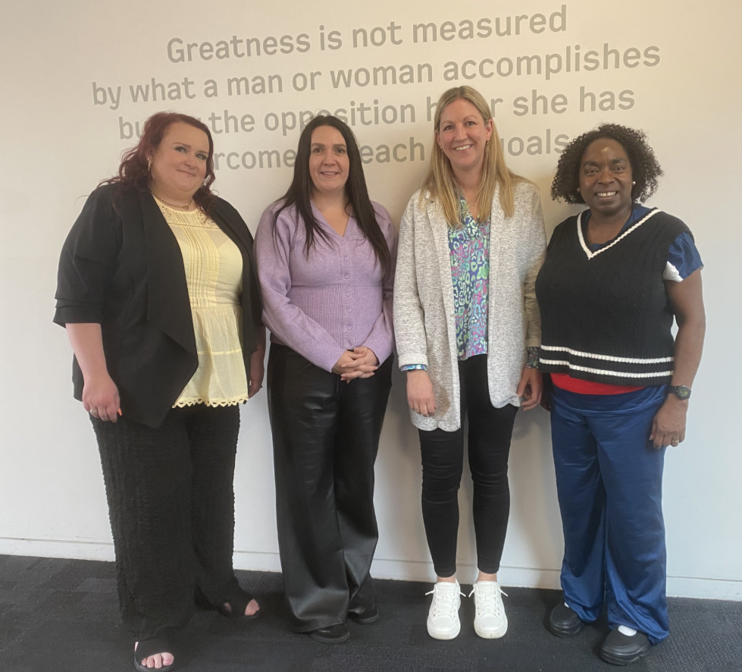
Building evidence in the UK
Stephanie, Kirsten, Faye and Yewande, our Navigators
Pilot randomised control trial in 4 local authorities – Blackpool, Newham, Oxfordshire and Rochdale, funded by Foundations and evaluated by CEI/Ipsos
Programme delivery started in June 2026 for 1 year
Aim to assess if the international evidence base applies in the UK context with different legal framework, statutory system and communities
Part of our broader commitment to co-design with kinship carers, partnership with local authorities, developing evidence, improving practice and building an ecosystem of support for kinship families

Slide 34
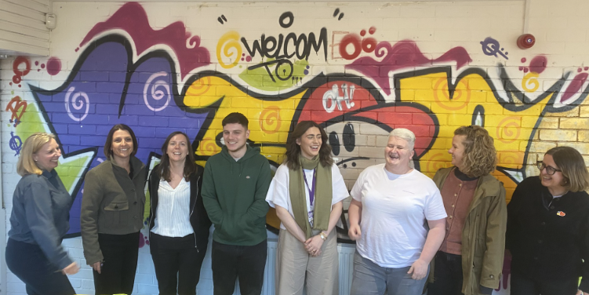
Innovating whole family support
Y Sort It mentors and a Kinship Navigator
New partnership with the InTandem established mentoring programme for kinship children and young people in Scotland
Y Sort It will support children and young people with referral routes to and from Kinship Connected navigators who will support their kinship carers
Funded by National Lottery UK Fund
Delivery from Autumn 2026
We look forward to sharing learning
Add Inspiring Scotland news

Slide 35
Reflections on the morning
Dr Beverley Barnett-Jones, Trustee of Kinship and Nurture Futures Co-Founder
Tim Fisher, Practice Lead, Kinship

Slide 36
Lunch

Slide 37
Kinship Care Week
5 – 11 October 2026

Slide 38

About Kinship Care Week
Kinship Care Week is a time to shine a light on the vital role of kinship carers and celebrate all kinship families - while highlighting the realities of stepping up to care for a child who has had a difficult start in life.
Your involvement, even in small ways, can make a big difference, particularly in helping kinship carers in your area feel valued. Local authorities and other professionals and partners have a really important role to play to:
  to build awareness and understanding among professionals who may support them
  to signpost support for kinship carers in your area
  to listen to and amplify the voices of kinship carers and their children

Slide 39
What you can do
1. Raise awareness & visibility of kinship families
Add KCW to your comms planner – post about in on social media and include in newsletter to raise awareness of kinship care and signpost available support.
Encourage local leaders to publicly recognise kinship carers through statements or short videos.
Promote Kinship support services by displaying posters from the Kinship digital toolkit in public spaces such as libraries and community centres.
Share stories of kinship carers in your area (with permission).
Follow and share content from Kinship’s social media channels during #KinshipCareWeek

Slide 40
What you can do
2. Engage and inform staff and partners
Share Kinship Care Week communications internally.
Highlight best practice and practical insights in supporting kinship families across your workforce.
Encourage colleagues, including social workers and frontline staff, to join the Kinship Professionals Network to stay informed and share learning.
Work with local community organisations and partners to improve awareness and ensure consistent signposting to support - and create links to your kinship local offer.

Slide 41
What you can do
3. Host an event with kinship carers
Host a Kinship Care Week tea party or similar local event to bring kinship carers and families together.
Organise listening sessions where kinship carers can share their experiences directly with decision-makers.
Involve kinship carers in helping to develop or review your Kinship Local Offer. Kinship can help you to organise this.

Slide 42
Workshops

Slide 43
Feedback from workshops

Slide 44
Closing remarks
Dr Lucy Peake, CEO, Kinship

Slide 45
Kinship 2026 Knowledge Exchange: Building the kinship care system that families need: Where are we now and what's next for policy and practice?
LinkedIn: @kinship-charity
Thank you for attending

