Slide 1
Managing challenging behaviour with children in kinship care​
Al Coates MBE

Slide 2
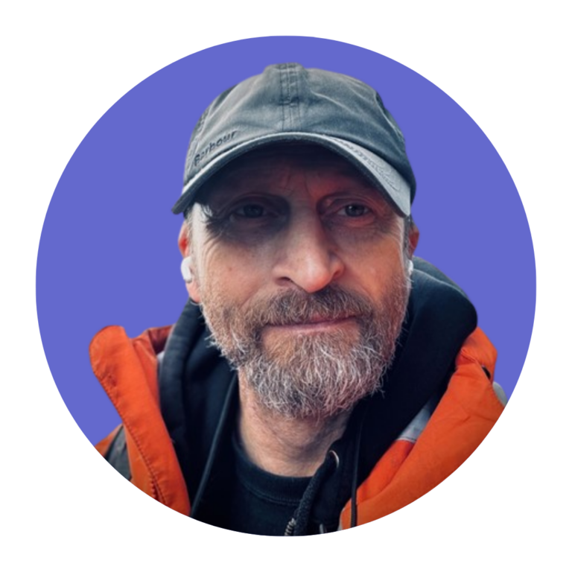
About Al Coates MBE
Al (he/him) is an independent social worker, who supports kinship carers to manage challenging and aggressive behaviour – a subject he’s co-authored several publications about.​
Al and his wife have extensive personal experience, having adopted three children themselves in 1999, then becoming foster carers to two more in 2008. They went on to adopt those children and their sibling in 2013. In the same year, Al qualified as a social worker and has worked in fostering since. ​
He has used his own experience to campaign and raise issues around adoption and fostering, working since 2015 with the Department of Education. Al was awarded an MBE in 2018 for services to adoption, and has founded/co-hosts the Adoption & Fostering Podcast.​

Slide 3
We are Kinship. The leading kinship care charity in England and Wales.
By supporting, advising and informing kinship carers, and campaigning for fairer services, we are changing lives, changing the system.

Slide 4





Working together
Confidentiality
Duration of the session
One voice and respect for others
Disturbances and mobiles
Sharing what is comfortable

Slide 5
Housekeeping
About the room or online set-up​
About the venue​
Breaks

Slide 6
Agenda
Develop effective strategies to reduce and manage challenging and/or aggressive behaviour​
Develop understanding around why children’s behaviour may be challenging and/or aggressive​
Find and explore further information and support

Slide 7
Risk factors
Underlying causes for children's challenging/ aggressive behaviour

Slide 8
What we mean by challenging behaviour
bullying​
defiance/refusal​
ignoring​
insults​
lying
physical violence​
property destruction​
threats​
withdrawn

Slide 9
The impact of children’s challenging/aggressive behaviour on carers
isolation/stigma/shame
mental and physical ill health
altered:
  perception of self
  perception of others
  relationships with others
trauma

Slide 10
Trauma definition
when we experience very stressful, frightening or distressing events that are difficult to cope with, or out of our control
this could be one incident, or an ongoing event happening over a long period of time

Slide 11
Experience
Biology
Systems
"There is never just one cause for complex behaviour. ​
‘Explanations’ of a child's behaviour may be in terms of the individual (genetic/ biological and past experience), the family and wider society."​
Gallagher

Slide 12
Our children’s lived experiences
abuse​
adversity​
loss/separation​
pre-birth exposure to alcohol/drugs/trauma​
trauma

Slide 13
Our children’s biology
ASD (autistic spectrum disorder)​
ADHD (attention deficit hyperactivity disorder)​
developmental trauma​
FASD (fetal alcohol spectrum disorder)​
insecure/complex attachments​
learning disability/ies​
PDA (pathological demand avoidance)​
sensory challenges

Slide 14

Window of tolerance
Dr Dan Siegel
Hyper-arousal
angry anxious – defensive – dysregulated – fearful – panicked – hypervigilant
Optimal arousal​
Hypo-arousal
lack of energy – numbness – no feelings – lack of energy – inability to think or respond
reduced physical movement – ashamed

Slide 15

Window of tolerance
Dr Dan Siegel
Hyper-arousal
angry anxious – defensive – dysregulated – fearful – panicked – hypervigilant
Optimal arousal​
Hypo-arousal
lack of energy – numbness – no feelings – lack of energy – inability to think or respond
reduced physical movement – ashamed

Slide 16
The "systems" our children live in
the 'family systems theory' states families function as a system – each member plays a role and follows certain rules
based on these system roles, people are expected to interact with and respond to each other in certain ways

Slide 17
Systems our children live in
All with distinct boundaries, challenges, expectations, rules etc
classroom​
community​
family​
groups/clubs​
home​
school yards

Slide 18
What we can do
Effective strategies to reduce and manage challenging and/or aggressive behaviour

Slide 19
Change what we can
Take care of ourselves (self-care):
mind
body
soul

Slide 20
De-escalate
avoid situations​
choose words carefully​
distract​
plan ahead/anticipate challenges​
speak words carefully
step back from hazards
pick your battles

Slide 21
Three Rs
Dr Bruce Perry
REGULATE
Help child regulate – calm their fight/flight/freeze responses
RELATE
Connect with them through an attuned, sensitive relationship
REASON
Support child to reflect, learn, remember, articulate, become self-assured

Slide 22
Regulate
(Brainstem/mid – or the "sensory" brain)
Help the child to regulate and calm their fight, flight or freeze. Offer soothing comfort and reassurance.
Empathise with and validate the child’s feelings, so they are seen, heard and understood:
choose words carefully​
be prepared/anticipate challenges​
step back

Slide 23
Relate
(Limbic - or the "emotional regulation" brain)
Relate and connect with the child through an attuned, sensitive relationship. Acknowledge that this is unpleasant and:
be together (physical proximity)
offer comfort/food
identify, acknowledge, empathise and validate feelings
reassure that you're there when they're ready

Slide 24
Reason
(Cortical – or the "great human thinking" brain)
Support the child to reflect, learn, remember, articulate and become self-assured:​
avoid "why" questions​
look for solutions or ways to avoid it happening again​
make sense of what happened​
not a time for consequences​
strike while the iron is cold​
teach self-regulation strategies

Slide 25
Building and finding support

Slide 26
Support network
Barriers to getting help:​
don't want to be a burden (or burden others)​
fear of: ​
  being judged or rejected ​
  being seen as a ‘bad parent/carer’ ​
  child’s reaction, disloyalty to child ​
  role change (only comfortable supporting others)

Slide 27
Support network
What do you need?
buffer
logistic supporters
mediator
mentor
practical help
protector
sibling supporter

Slide 28
Support network
What they offer:​
comfort and support ​
challenge carer’s thinking and behaviour (if needed)​
deter child from violence​
legitimise carer’s position​
reduce isolation

Slide 29
Support from Kinship
Advice service
0300 123 7015
kinship.org.uk/advice
Workshops and training
kinship.org.uk/events
Peer support groups
kinship.org.uk/groups

Slide 30
Support from Kinship
Someone like me ​
kinship.org.uk/​someone-like-me
Kinship Compass
kinship.org.uk/​compass
Kinship Community
kinship.org.uk/community

Slide 31
Any questions or comments?

Slide 32
Other external support
Al's website
Beacon House – resources to understand children with complex needs
CAPA First response – support for carers/parents of children with aggressive/challenging behaviour
Beacon Family Services – resources to support children

Slide 33
References
Gallagher E (n.d) – 'Childrens violence to parents'​
Mi-Psych | Mindfulness & Clinical Psychology Solutions (2021) – Emotion regulation 101: your window of tolerance​
Mind (2023) – About trauma​
Herman, J.L. (1992) – Complex PTSD: A syndrome in survivors of prolonged and repeated trauma. Journal of Traumatic Stress, 5(3), p.377–391 ​
Dr Dan Siegel – The Developing Mind, 3rd edition​

Slide 34
This workshop was developed with funding from the Department for Education. Next steps:​
evaluation form ​
future workshops

Slide 35
www.kinship.org.uk

